Slide 1
Hybridisation
This mixing and redistribution of energy is called hybridisation and the resultant orbitals are called hybrid orbitals.
Hybridisation is a hypothetical concept and has been introduced by Pauling and Slater
Hybridisation Rules
The orbitals of similar energies take part in hybridisation.
Number of hybrid orbitals formed is always equal to the number of atomic orbitals which have taken part in the hybridisation.
Generally, all the hybrid orbitals are similar but they are not necessarily identical in shape. They may differ from one another mainly in shape.
Hybrid orbitals form only sigma bonds

Slide 2
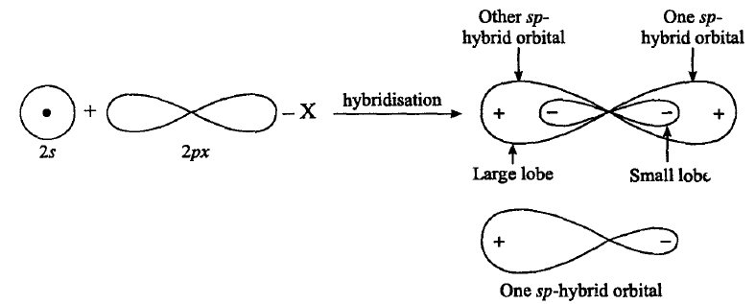
sp or Digonal Hybridisation :
In this type of hybridisation one s and one p-orbital of the valence shell of central atom of the given molecule combine to form two sp hybrid orbitals as follows:

Slide 3
Characteristic of sp-Hybrid Orbitals
Both sp-hybrid orbitals are completely equivalent and symmetrical.
Energy of sp-hybrid orbital is more than s-orbital but less than the p-orbital.
These two sp-hybrid orbitals are collinear, i.e., angle between the hybrid orbitals is 180°.
Shape of sp-hybrid orbital is oval.
Its relative power of overlapping is 1.93 with respect to s orbital.
In sp-hybrid orbital one lobe is bigger while other lobe is small. The bigger lobe is very large with respect to p-orbital, hence it has higher degree of overlapping. Thus it forms stronger bond.

Slide 4
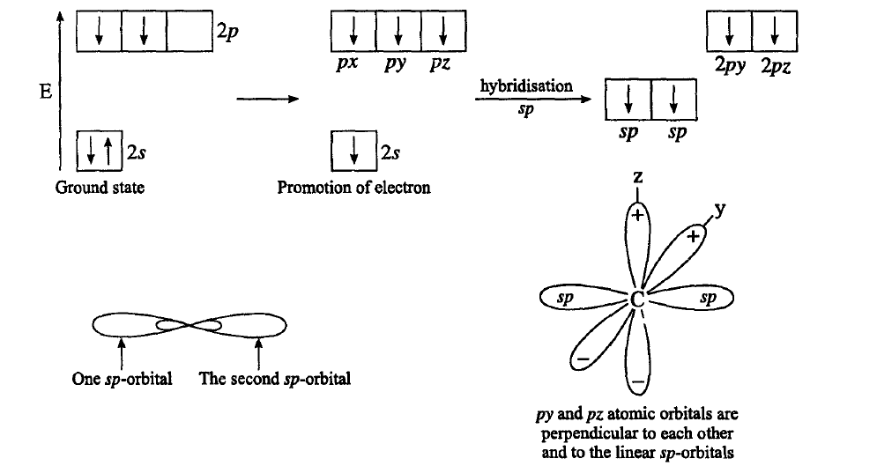
Example: Acetylene (C₂H₂)

Slide 5
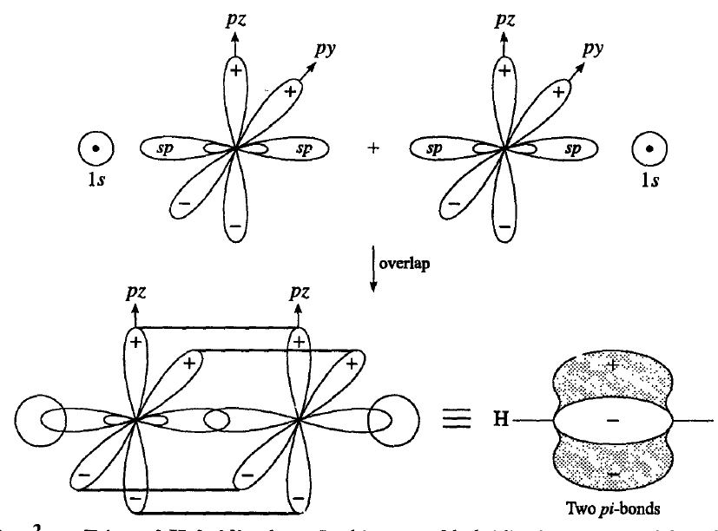

Slide 6
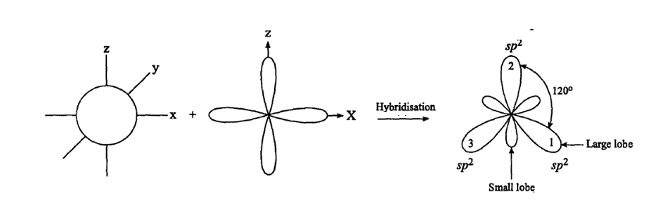
sp² or Trigonal Hybridisation :
In this type of hybridisation one s and 2p orbitals of the valence shell of central atom of the given molecule combine to form three sp²-hybrid orbitals as shown below:

Slide 7
Characteristics of sp² Hybridisation :
(1) These sp²-hybrid orbitals are completely equivalent and symmetrical.
(2) These hybrid orbitals are planar with bond angle 120°.
(3) Since in this hybridisation contribution of p-orbitals is more hence it is less oval than sp-hybrid orbitals. In this case one lobe is bigger and one lobe is smaller and it forms stronger bond.
(4) These are stronger than s and p orbitals. Its relative power of overlapping is 1.99 with respect to s-orbital

Slide 8
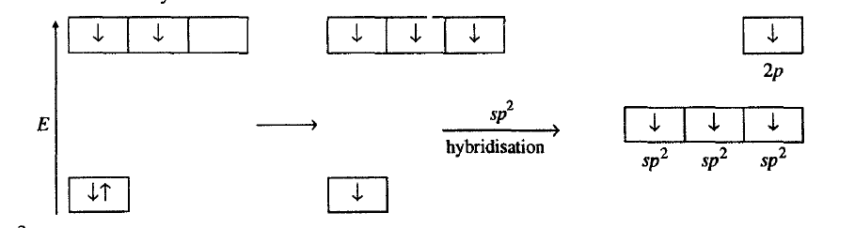
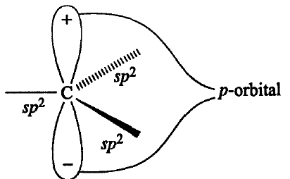
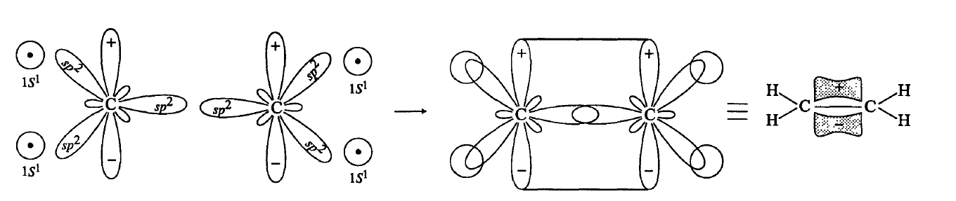
Example: Ethylene (C₂H₄)

Slide 9
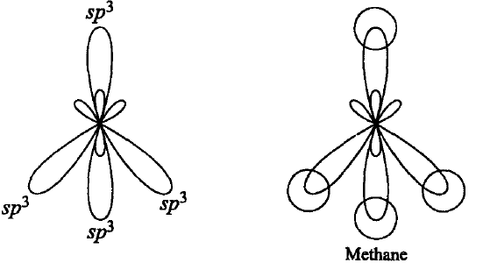
sp³ or Tetrahedral Hybridisation:
In this hybridisation one s and three p-orbitals of the valence shell of central atom of the given molecule combine to form four sp³-hybrid orbitals.

Slide 10
Characteristics of sp³ Hybridisation :
(1) All the four sp³ hybrid orbitals are completely equivalent and symmetrical.
(2) These orbitals are directed towards the four comers of a regular tetrahedron and the angle between each pair of them is 109° 28' or 109.5°.
(3) Their relative power of overlapping is 2.00 with respect to s-orbital. This shows that sp³ -orbitals are stronger than sp which is stronger than sp-orbitals.
(4) Since in sp³-hybridisation the contribution of p-orbitals is 75%, its shape is almost same as that of the parent p-orbitals except that the bigger lobe in sp³ -orbital is somewhat more spread and shorter in length than the pure p-orbitals

Slide 11
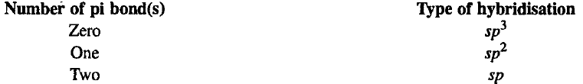
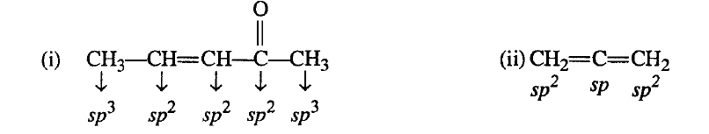
Hybridisation in Organic Species
Hybridisation in organic species can be known by two methods:
First Method:
In this method hybridisation can be known by the number of pi bonds present on that particular atom.
Example
This method cannot be used for those atoms of the molecule which have positive charge, negative charge or odd electron

Slide 12
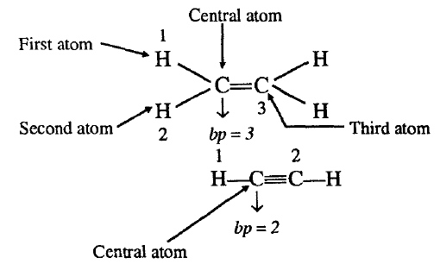
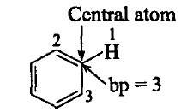
Second method:
Electron pair method
ep = bp + lp
where
ep = electrons pair present in hybrid orbitals
bp = bond pair present in hybrid orbitals
lp = loan pair present in hybrid molecule
Determination of bond pairs :
Number of bp = Number of atoms present on central atom of the species

Slide 13
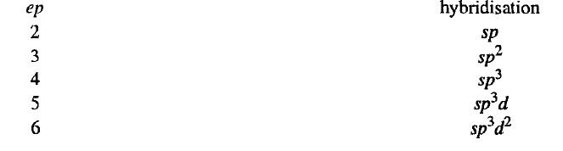
Determination of lone pair of electrons:
Number of Ip's can be determined as follows:
(i) If carbon has pi bond/(s) or positive charge or odd electron, then lp on carbon will be zero.
(ii) If carbon has negative charge, then Ip will be equal to one.
Number of electron pairs tells us the type of hybridisation as follows:

Slide 14
