Slide 1
IUPAC System
IUPAC: International Union of Pure and Applied Chemistry
For naming simple aliphatic compounds, the normal saturated hydrocarbons have been considered as the parent compounds and the other compounds as their derivatives obtained by the replacement of one or more hydrogen atoms with various functional groups. Each systematic name has two or three of the following parts:
Root word,
Primary suffix,
Secondary suffix.

Slide 2
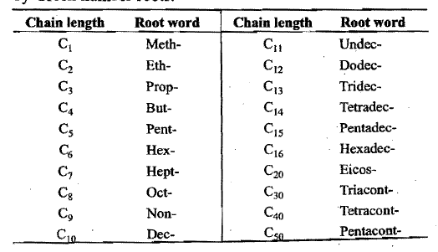
(i) Root words:
The basic unit is a series of root words which indicate linear or continuous chains of carbon atoms
In general, the root word for any carbon chain is alk-.

Slide 3
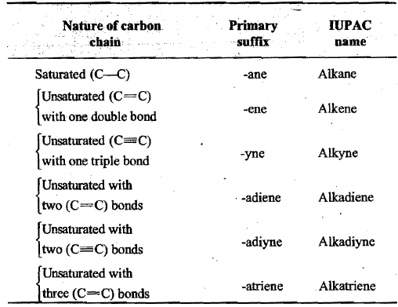
(ii) Primary suffixes:
Primary suffixes are added to the root words to show saturation or unsaturation in a carbon chain.

Slide 4
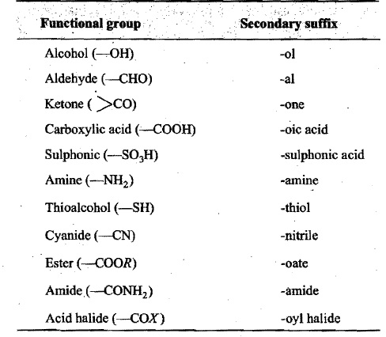
(iii) Secondary suffixes:
Suffixes added after the primary suffix to indicate the presence of a particular functional group in the carbon chain are known as secondary suffixes.

Slide 5
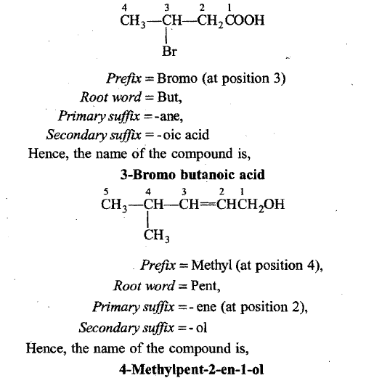
IUPAC Name = Prefix(es) + Root word + Primary suffix + Secondary suffix

Slide 6
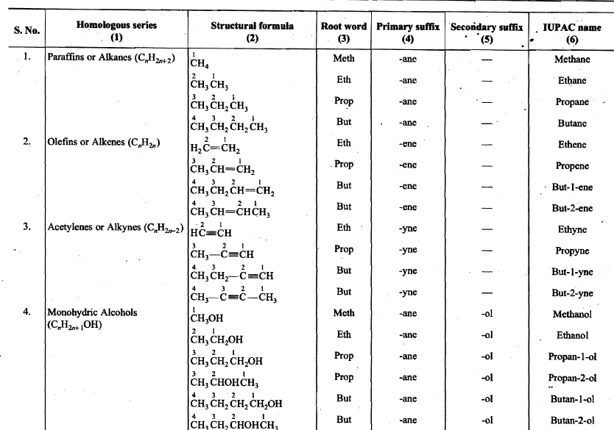

Slide 7
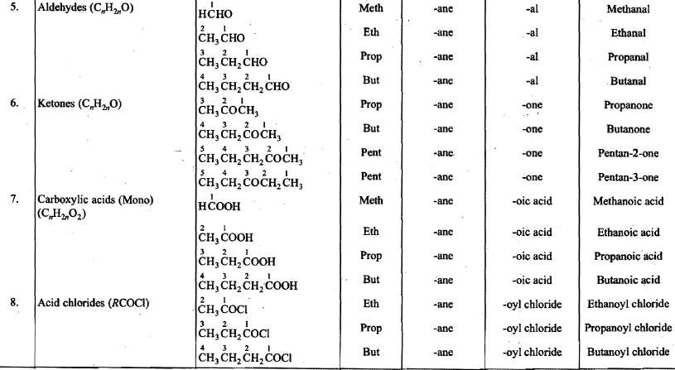

Slide 8
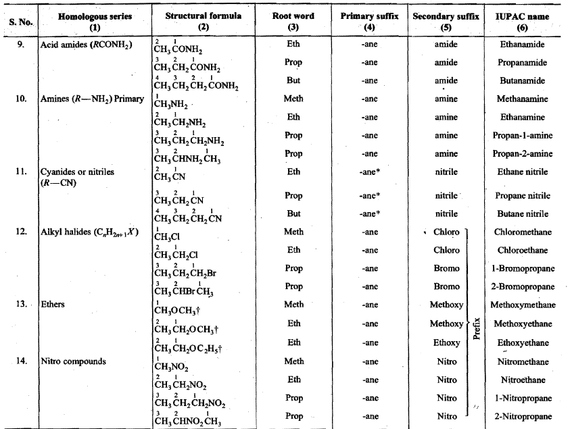

Slide 9
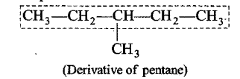
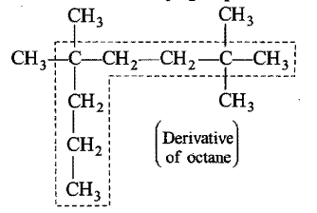
IUPAC SYSTEM OF NOMENCLATURE OF COMPLEX COMPOUNDS
(A) Rules for Naming Complex Aliphatic Compounds when no Functional Group is Present (Saturated Hydrocarbons or Paraffins or Alkanes)
Longest chain rule:
The first step in naming an organic compound is to select the longest continuous chain of carbon atoms which may or may not be horizontal (straight). This continuous chain is called parent chain or main chain and other carbon chains attached to it are known as side chains (substituents).

Slide 10
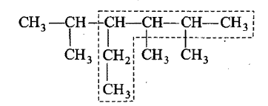
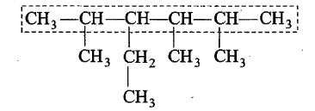
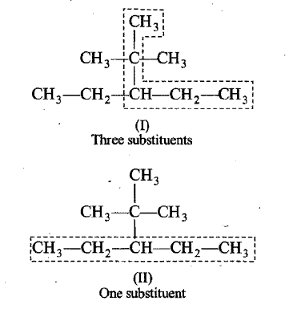
It is possible that sometimes there may be two or more carbon chains of equal lengths in the molecule. In such a case the selected chain should (a) contain maximum number of side chains (substituents) or (b) have the least branched side chains.

Slide 11
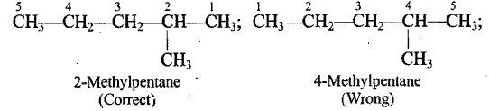
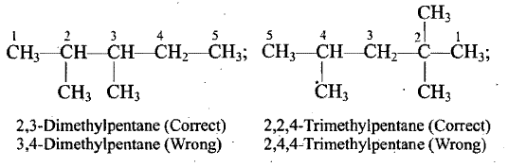
2. Numbering of the carbon atoms of the longest chain:
The carbon atoms of the longest continuous chain (parent chain) are numbered by arabic numerals 1, 2, 3, 4 ... etc., from one end to the other. The number that locates the position of the substituent is known as Locant.
The carbon atoms carrying the first substituent get the lowest possible number (lowest individual number rule or lowest locant rule).
(b) In case, there are two or more similar substituents attached to the parent chain, their positions are indicated separately by the prefixes such as di, tri, tetra, etc.

Slide 12
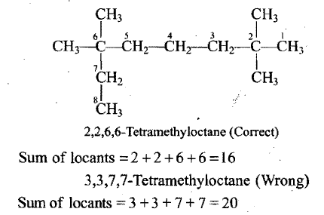
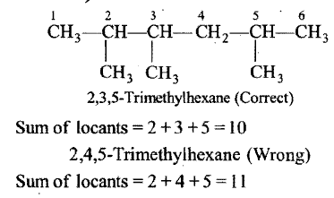
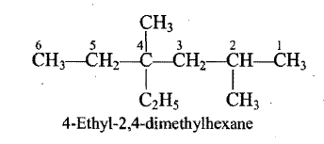
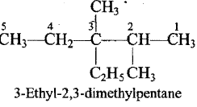
(c) When many substituents are present, the numbering is done from the end where upon the sum of locants is the lowest (Lowest sum rule).
d) If there are different alkyl substituents attached to the parent chain, their names are written in the alphabetical order.1t may be noted , that prefixes such as di, tri, etc., are not considered while arranging the substituent alphabetically.

Slide 13
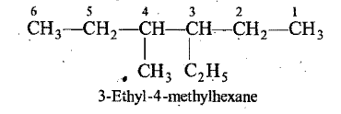
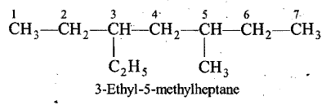
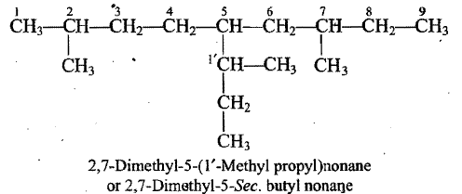
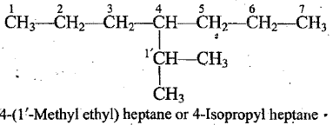
(e) In case, there are different alkyl substituents at equivalent positions, then' numbering of the parent chain is done in such a way that the alkyl group which comes first in the alphabetical order gets the lower number.
f) Naming the complex alkyl substituents: When the substituents on the parent chain has itself branched chain, it is named as substituted alkyl' group and its carbon chain is separately numbered in such a way, that the carbon atom directly attached to the parent chain is given number 1'. The name of this complex substituent is written in brackets. To avoid confusion with the number of carbon atoms of the parent chain

Slide 14
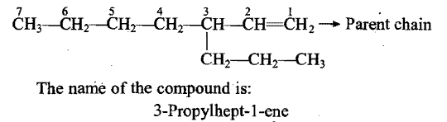
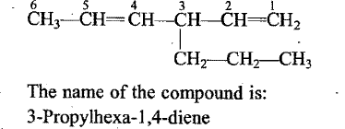
[B] Rules for Naming Complex Unsaturated Aliphatic Hydrocarbons
(1) Longest chain: In the case of unsaturated hydrocarbons, the longest chain of carbon atoms (parent chain) is so selected as to include the double or triple bond even if it is not the actual longest chain of carbon atoms.
When more than one double or triple bond is present in the molecule, the longest chain of carbon atoms is so selected that it includes maximum number of such bonds even if it is not the actual longest chain.

Slide 15
2) A primary suffix is added to the root word to indicate the presence of double or triple bond in the parent chain.
For one double bond = Root word + locant + ene
For one triple bond = Root word + locant + yne
In case the parent chains contain two or more double bonds (two or more triple bonds), the prefixes di-, tri, tetra, etc., are used before primary suffix.
For two double bonds = Root word + locant +diene
For two triple bonds = Root word + loeant + diyne

Slide 16

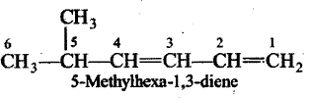
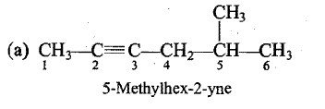
(3) Numbering of carbon chain; The parent carbon chain is numbered in a manner so as to give lowest number to that carbon atom linked by double or triple bond even if it violates the rules of saturated hydrocarbons
(4) Alkyl groups or other substituents' are numbered, named and placed as prefixes in alphabetical order.

Slide 17
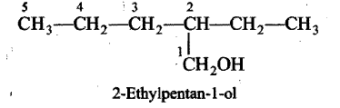
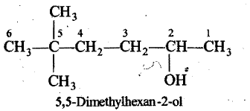
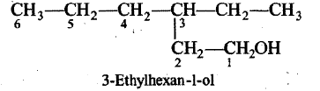
[C] Rules for Naming Complex Aliphatic Compounds Containing One Functional Group
(1) Longest chain: The parent carbon chain is so, chosen as to include the functional group even if it is not the actual longest continuous chain.
(2) Numbering of. parent chain: The numbering of the parent carbon chain is done in such a way that the carbon linking to functional group gets the lowest number even if there is violation of saturated hydrocarbon rules.
When a chain terminating group such as -CHO, -COOH, COOR, -CONH₂, -CN, etc., is present as the functional group, it must be assigned number 1. This does not apply to non terminal groups such as >CO, -NH₂ and –OH, which may or may not be assigned 1.

Slide 18
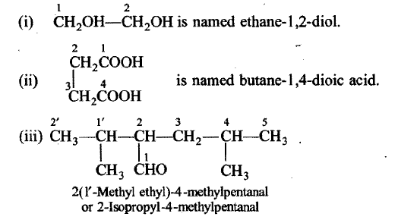
3) The last 'e' of the primary suffix is dropped and the secondary suffix representing the functional group is added. The number giving the position of the functional group is inserted in the name.
(4) The names of the substituents are prefixed to the parent hydrocarbon according to IUPAC rules with alphabetical order without considering the presence of functional group. Halo and nitro groups are considered as substituents.
(5) Numerical prefixes di-, tri, tetra-, etc., are attached before the designations of functional group if two or more identical groups are present

Slide 19
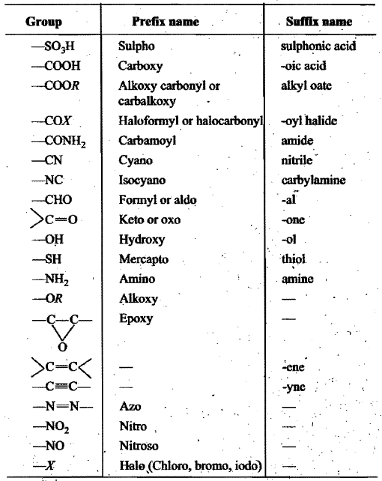
(D] Rules for Naming Aliphatic Compounds Having Polyfunctional Groups
Seniority Table for Principal Groups (Highest Priority Group at the Top)

Slide 20
The first step in the naming of poly functional compounds is the selection of principal functional group. The principal Groups gives the class name of the structure
The second step is the selection of Parent chain. The parent chain is so selected that it includes the maximum number of functional groups including the principal group.
The third step is the numbering of parent chain. The parent chain is numbered from the side of principal functional group; i.e., it gets lowest number. The following decreasing order of preference for giving the lowest numbers is followed. Principal functional group > Double bond or Triple bond > Substituents.
Substituents, side chains and secondary functional groups are named in alphabetical order.

Slide 21
If a molecule contains both carbon-carbon double or triple bonds, the two are treated at par in seeking the lowest number combination. However, if the sum of numbers turns out to be the same starting from either of the carbon chain; then lowest number is given to the C-C double bond. Such compounds are named as alkenynes.

Slide 22
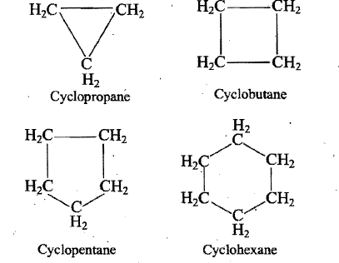
IUPAC NOMENCLATURE OF ALICYCLIC COMPOUNDS
Cycloalkanes:
Cycloalkanes are alkanes in which carbon atoms are arranged in a ring. These are named by adding the prefix cyclo to the name of alkane having the same number of carbon atoms as in the rings
Substituted cycloalkanes are named as alkyl cycloalkanes. The numbering of the carbon atoms in the ring is done in such a way that the substituent which comes first in the alphabetical order is given the lowest possible number provided it does not violate the lowest set of locants rule.

Slide 23
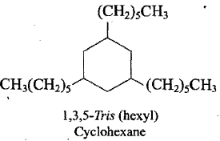
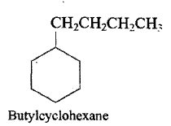
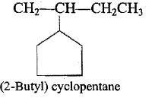
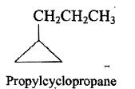
When the ring contains more or equal number of carbon atoms than the alkyl group attached to it, then it is named as a derivative of cycloalkane and the alkyl group is treated as substituent.

Slide 24
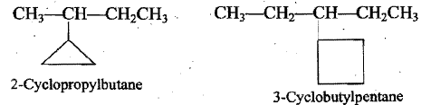
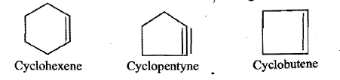
In case, the alkane chain contains greater number of carbon atoms than present in the ring, the compound is considered as the derivative of alkane and the ring is designated as substituent.
(2) Cycloalkenes and cycloalkynes:
The word cyclo is prefixed before the name of alkene and alkyne having the
same number of carbon atoms as in the ring

Slide 25
In the case of substituted cycloalkenes and cycloalkynes, the numbering of double or triple bond is done as 1 and 2, the direction is so chosen as to give lowest numbers to the substituents.

Slide 26
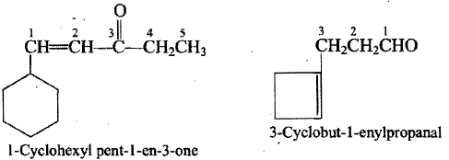
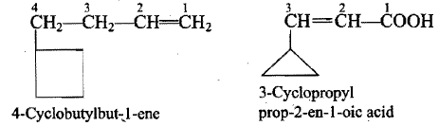
(3) Alicyclic compounds containing functional group:
Alicyclic alcohols, amines, aldehydes, ketones, acids, etc. are named in the same fashion as corresponding aliphatic compounds by prefixing the word cyclo before the name
If however, the side chain contains a multiple bond or a functional group, the alicyclic ring is treated as substituent irrespective of the size of the ring.

Slide 27
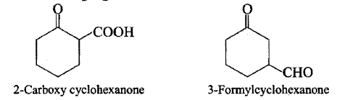
In case of cyclic ketones any functional group present in the ring is treated as substituents (even -CHO, -COOH etc.) and keto group is always treated as principal functional group. This is because carbon of the keto group is a part of the
ring. This rule is applicable till the number of carbon atoms in substituent is less or equal to the number of carbon atoms present in the ring .

Slide 28
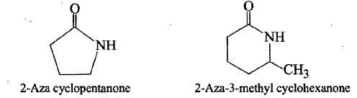
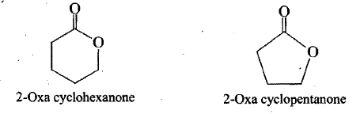
Cyclic amides are called Lactams. The IUPAC name of these compounds are Azacycloalkanone
Cyclic esters are called Lactones. The IUPAC name of these compounds are Oxacycloalkanone.

Slide 29
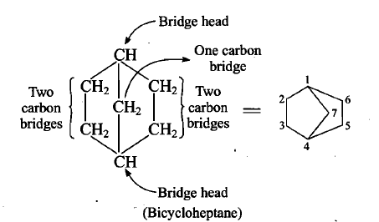
Nomenclature of Bicyclo and Spiro Compounds
Bicyclo compounds contain two fused rings with the help of a bridge.
We use the name of the alkane corresponding to the total number of carbon atoms as the base name.
The carbon atoms common to both the rings are called bridge heads, and each bond or chain of atoms connecting the bridge head atoms, is called a bridge.

Slide 30
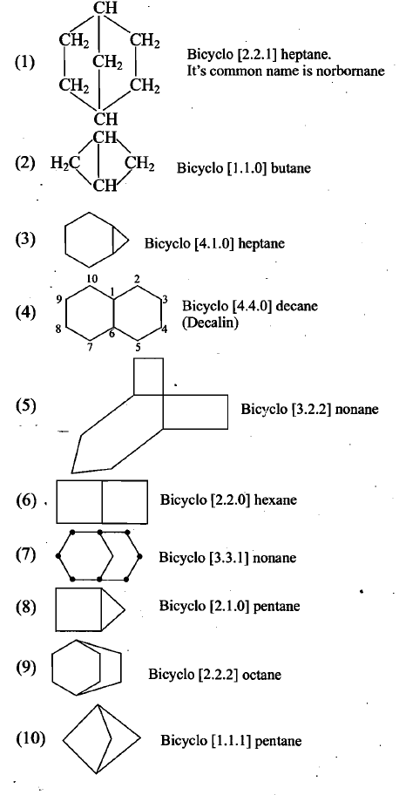

Slide 31
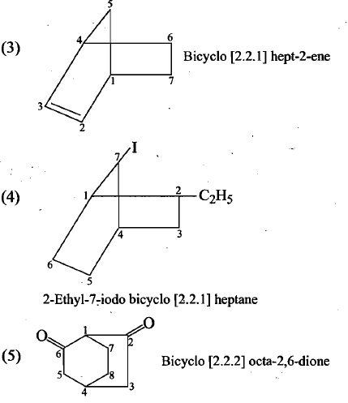
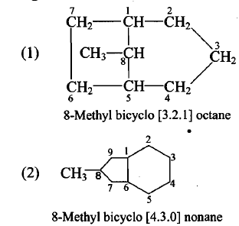
If substituents are present, we number the bridged ring system beginning .at one bridge head, proceeding first along the longest bridge to the other bridge head, then along the next longest bridge back to the first bridge head. The shortest bridge is' named the last.

Slide 32
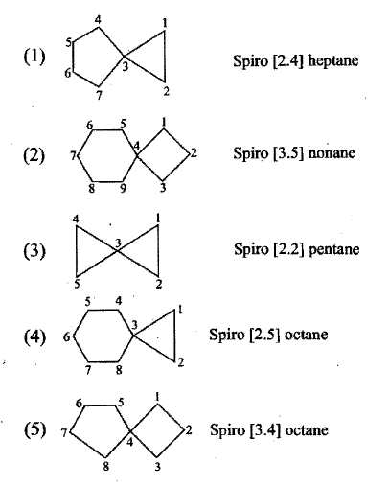
Spiro compounds:
If two rings are joined by quaternary carbon at the apex, then they are prefixed by the word spiro followed by brackets containing the number of carbon atoms in each ring in ascending order and then by the name of parent hydrocarbon containing total number of carbon atoms in the two rings. The numbering starts from the atom next to the spiro atom and proceeds through the smaller ring first.

Slide 33
ISOMERISM
Organic compounds having same molecular formula but differing from each other at least in some physical properties or chemical properties or both are known as isomers and the phenomenon is known as isomerism.
The term isomer was first introduced by Berzelius (Greek: Iso"", equal, meros parts).
The difference in properties of isomers is due to the difference in the relative arrangements of various atoms or groups present in their molecules.
There are two main types of isomerism:
1. Structural isomerism or constitutional isomerism
2. Space or stereoisomerism

Slide 34
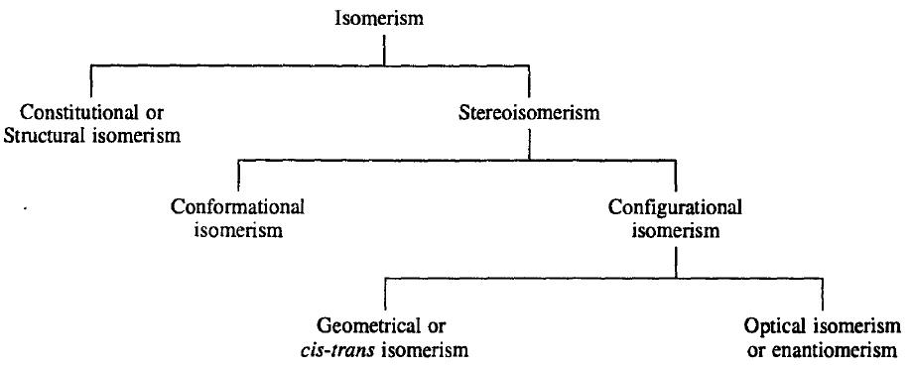

Slide 35
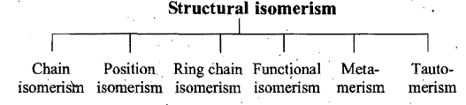
1. Structural isomerism:
It is due to the difference in the manner in which the constituent atoms or groups are linked to one another within the molecule, without any reference to space.
Structural isomers are compounds having same molecular 'formula' but different structural formulae. Structural isomerism is further classified into different types:

Slide 36

2. Space or stereoisomerism :
It is due to the difference in relative arrangement of atoms or groups in space.
Stereo isomers are compounds having the same molecular and structural formulae, but different spatial arrangement of atoms or groups. The spatial arrangement of atoms or groups is also referred to as configuration of the molecule.

Slide 37


1. CHAIN OR NUCLEAR ISOMERISM
This type of isomerism is due to difference in the arrangement of carbon atoms constituting the chain, i.e., straight or branched chain of carbon atoms. It is also known as, nuclear or skeletal isomerism.
The isomers showing chain isomerism belong to same homologous series.

Slide 38

2. POSITION ISOMERISM
It is due to the difference in the positions occupied by the particular atom or group (substituents) in the same carbon chain or due to different positions of double or triple bonds in alkenes and alkynes.

Slide 39
Aldehydes, carboxylic acids (and their derivatives), and cyanides do not exhibit position isomerism.

Slide 40

3. RING-CHAIN ISOMERISM
This type of isomerism is due to different modes of linking of carbon atoms, i.e., the isomers possess either open chain or closed chain structures.

Slide 41

4, FUNCTIONAL ISOMERISM
Compounds having same molecular formula but different functional groups in their molecules show functional isomerism and are called functional isomers.
Since functional group determines largely the properties of a compound, such isomers differ in their physical and chemical properties.

Slide 42



Slide 43

5. METAMERISM
It is the isomerism in the same homologous series. It is due to the presence of different alkyl groups attached to the same polyvalent functional group or atom (i.e., -S-, -O-, -NH- and -CO-) So, the compounds having same molecular formula but different structural formulae due to different (size or nature) alkyl groups on either side of the functional group are called metamers and the phenomenon is known as metamerism.

Slide 44


6. TAUTOMERISM
This is a special type of functional isomerism where the isomers exist simultaneously in equilibrium with each other.
or
The type of isomerism in which a substance exists in two readily interconvertible different structures leading to dynamic equilibrium is known as tautomerism -and the different forms are called tautomers.

Slide 45
Stereoisomerism
Isomers having the same connectivity of the atoms (i.e., the same constitution) but different spatial arrangement of their atoms are known as stereoisomers and the isomerism exhibited by them is called stereoisomerism.
There are two types of stereoisomerism :
1. Configurational isomerism
2. Conformational isomerism.

Slide 46
Configurational Isomerism
The different spatial arrangements of atoms in a molecule which are not interconvertible without breaking of bond(s) are called configurations or configurational isomers and the isomerism exhibited by them is called configurational isomerism.
There are two kinds of configurational isomerism:
1. Optical isomerism (enantiomerism);
2. Geometrical (cis-trans) isomerism.

Slide 47
Because configurational isomers cannot interconvert, configurational isomers can be separated.
Changing the configuration of a molecule always means that bonds are broken.
A different configuration is a different molecule.

Slide 48

Optical Isomerism (Enantiomerism)
Isomers which are non superimposable mirror images of each other are called enantiomers and the isomerism exhibited by them is known as enantiomerism. Enantiomers are also called mirror-image isomers, enantiomorphs or optical antipodes.
The stereoisomers which are mirror images of each other are called enantiomers, and stereo isomers which are not mirror images of each other are called diastereoisomers (or diastereomers).

Slide 49

OPTICAL ACTIVITY
Ordinary light is composed of rays of different wavelengths vibrating in all directions perpendicular to the path of its propagation. The same is the case with a light of a single wavelength, i.e., a monochromatic light. These vibrations can be made to occur in a single plane (polarisation) by passing ordinary light through the polarising Nicol prism (made of calcite, a special crystalline form of CaCO₃). Such light whose vibrations occur in only one plane is called plane polarized light. The polarisation of ordinary light transmitted through a Nicol prism is easily detected by viewing through a second Nicol prism called analyser (Fig. 3.1).

Slide 50
Compounds which rotate the plane of polarised light are called optically active compounds and this property is known as optical activity.
If the compound rotates the plane of polarisation to the right (clockwise), it is said to be dextrorotatory (Latin: dexter = right) and is denoted by (+), or d.
If the rotation is to the left (anticlockwise), the compound is said to be laevorotatory (Latin : laevus = left) and is denoted by (-), or l.
The change in the angle of plane of polarisation is known as optical rotation.
The optical rotation is detected and measured by an instrument called polarimeter
The degree of rotation depends on the nature of the compound, the temperature, the solvent, the concentration of the solution, the length of the polarimeter tube, and on the wavelength of the light used.

Slide 51


[α] = specific rotation
t = temperature of the measurement
λ = wavelength of the light used (usually sodium D line, 5893 A)
α = observed angle of rotation
I = length of sample tube in decimeter
c = concentration of the sample in g/mL of solution

Slide 52

Chirality:
Object or molecules which are not superimposable on their mirror images are chiral and are said to possess chirality.
STEREOGENIC CENTRE
A carbon bonded to four different atoms or groups is called a chiral centre.
A stereogenic centre (stereocentre) is defined as an atom on which an interchange of any two atoms or groups results in a new stereoisomer. When the new stereoisomer is an enantiomer, the stereocentre is called a chiral centre.

Slide 53


Slide 54

REPRESENTATION OF THREE-DIMENSIONAL MOLECULES
Flying-wedge Representation
In this representation three types of lines are used in a standard way to indicate three-dimensional structures in a two-dimensional picture.
A solid wedge, (thick line) represents a bond projecting above the plane of the paper toward the observer.
Continuous lines - (solid lines) are bonds in the plane of the paper.
A broken wedge, (dashed lines) is a bond below the plane (i.e., a bond pointing away from the observer

Slide 55

Fischer Projection Formula
This is also called Fischer projection in which all bonds are drawn as solid lines with the understanding that horizontal bonds (both left and right) point toward the observer (above the plane of the paper) and vertical bonds point away from the observer (below the plane of the paper). The chiral carbon atom lies in the plane of the paper and usually it is omitted.

Slide 56

Sawhorse Formula
The sawhorse formula indicates the spatial arrangement of all the atoms or groups on two adjacent carbon atoms. The bond between the adjacent carbon atoms is represented by a diagonal line, usually from lower left to upper right, the left hand bottom end representing the atom nearest to the observer and the right hand top end the atom that is farther away. Two of the remaining bonds to the two atoms are drawn vertically and the other four at 120⁰ angles to these two as shown below:

Slide 57

Newman Projection
Similar to sawhorse formula, Newman projection represents the spatial arrangement of all the atoms or groups on two adjacent carbon atoms. Here a molecule is viewed along the axis of a carbon-carbon bond. The carbon atom toward the front is represented by a dot and the carbon atom toward the rear by a circle. The atoms or groups on the carbon atoms are shown as being bonded to
the dot or circle. For example :

Slide 58
GEOMETRICAL (CIS-TRANS) ISOMERISM
The isomerism which arises due to restricted (frozen) rotation about a bond in a molecule is known as geometrical or cis-trans isomerism.
Geometrical (cis-trans) isomerism is exhibited by a variety of compounds which may be classified as follows :
Compounds containing a double bond; C=C, C=N, N=N.
Compounds containing cyclic structure; homocyclic, heterocyclic and fused-ring, ring systems.
Compounds having restricted rotation about a single bond due to steric hindrance; some biphenyls.

Slide 59


Conditions for geometrical isomerism:
A compound will show geometrical isomerism if it fulfils the following two conditions :
There should be restricted (frozen) rotation about a bond in the molecule.
Both substituents on each carbon about which rotation is frozen (restricted) should be different

Slide 60

Nomenclature of Geometrical Isomers
cis-trans nomenclature:
Compounds of the type abC=Cab can exist in the following two forms due to frozen rotation about carbon-carbon double bond.

Slide 61

2. E - Z system of nomenclature:
This nomenclature of geometrical isomers is more general and can be applied to all compounds.
E - Z nomenclature is based on the Cahn-Ingold Prelog system.
In the E - Z system the group of highest priority on each carbon atom is identified by using the sequence rules.
If the highest priority groups are on the same side of the double bond, the configuration is Z (German : zusammen = together), and if they are on the opposite sides, the configuration is E (German: entgegen = opposite).

Slide 62
Sequence Rules
The priorities of the four ligands (atoms or groups) attached to a chiral centre are decided by applying the following sequence rules. The sequence rules are arbitrary but consistent.
If all the four atoms directly attached to the chiral centre are different, sequence of priorities is determined by their atomic numbers, the atom of higher atomic number is given higher priority. e.g. I > CI > S > H
If two atoms are isotopes of the same element, the isotope of higher mass number has the higher priority. e.g; Br > C > D > H.

Slide 63
3. If two or more atoms attached to the chiral centre are the same, the priority is decided by applying the sequence rule 1 to the next to the next atoms in the groups and so on, if necessary, working outward from the chiral centre. When a group has branches the branch of highest priority is followed

Slide 64


4. If there is a double or triple bond, both double or triple bonded atoms are considered to be duplicated or triplicated. The priority sequence is then, determined by considering the structure containing the duplicated or triplicated atoms.

