Slide 1
Bond Lengths
The critical distance between the nuclei of two bonded atoms is known as the bond length or bond distance.
This distance ensures maximum stability of the covalent bond because at this distance the internuclear and interelectronic repulsions are completely balanced by the stabilizing effect of overlapping atomic orbitals
Unit = angstrom, 1 A = 10⁻⁸ cm
Methods for measuring bond lengths:
X-ray diffraction (only for crystals),
electron diffraction (only for gases),
spectroscopic methods

Slide 2
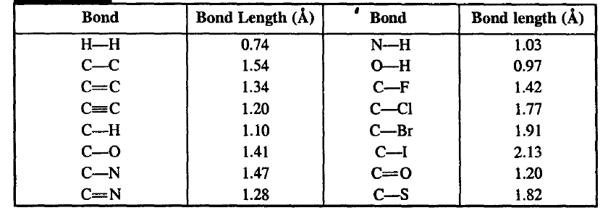
Since molecules are always vibrating the distance between atoms of a bond is not constant. Therefore, the measurements obtained are average values and different methods give different values.

Slide 3
Bond Strengths (Bond Energies)
There are two measures of bond strengths :
(i) Bond dissociation energy (D) and
(ii) Average bond energy (E)
Bond dissociation energy (D):
The energy required to break a particular bond (in the gaseous phase) to give free radicals (in the gaseous phase) is called the dissociation energy, D
The greater the bond dissociation energy, the stronger is the bond.

Slide 4
Average bond energy (E):
In poly atomic molecules, bond dissociation energies (D) are not identical even where apparently equivalent bonds dissociate
For example,
four equivalent C-H bonds dissociate successively, they have different values of D,
102 kcal/mole for CH₃-H,
105 kcal/mole for CH₂-H,
108 kcal/mole for CH-H,
83 kcal/mole for C-H.
Average value of the C-H bond energy = (102 + 105 + 108 + 83)/4 = 99.5 kcal/mole
Methane

Slide 5
The dissociation of a bond also depends on various factors
Resonance,
Hyperconjugation
Hybridisation,
Angle strain,
Steric effects, etc.
Usually average of all the D values of equivalent bonds is taken, and this average value is called the bond energy (E). Bond energy (E) may be measured from heat of atomization, but the more usual practice is to calculate it from the heat of combustion.

Slide 6
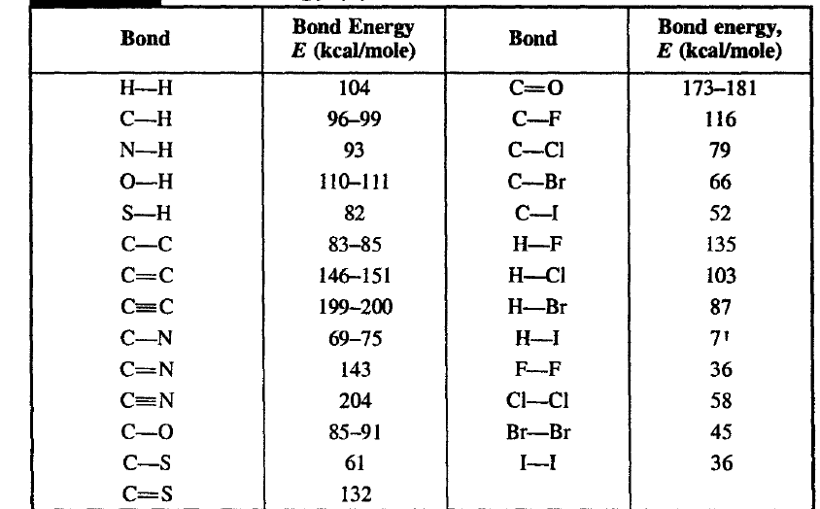
Bond energies are measures of bond strengths.
Shorter bonds are stronger bonds due to stronger- attraction between nuclei and electrons.
Double bonds are both shorter and stronger than single bonds, but not twice strong, because π overlapping is weaker than σ overlapping

Slide 7
Bond Angles
All atomic orbitals (except s orbital) have directional preferences, hence covalent bonds formed by their overlapping are also directional and have an angle between them.
The angle between the directions of two covalent bonds is known as the bond angle
The most important methods for determining bond angles are X-ray diffraction (only for crystals), electron diffraction (only for gases) and spectroscopic methods. Due to continuous atomic vibrations in molecules, the measured bond angles are average bond angles

Slide 8
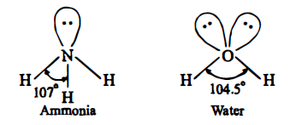
Bond angles give an idea of the geometries and shapes of molecules, as they depend on bond angles
Order of repulsions between electron pairs in the valence shell :
lone pair-lone pair > lone pair-bond pair > bond pair-bond pair
This order can be explained on the basis that the lone pair is under the influence of only one nucleus, hence its electron cloud will spread out in space to a greater extent than that of a bond pair, which is under the influence of two nuclei. This greater spread over of electron cloud in space results in a greater repulsion between a lone pair and another lone pair than that between a lone pair and a bond pair, and there is least repulsion between a bond pair and another bond pair of electrons.

Slide 9
Hybridisation
This mixing and redistribution of energy is called hybridisation and the resultant orbitals are called hybrid orbitals.
Hybridisation is a hypothetical concept and has been introduced by Pauling and Slater
Hybridisation Rules
The orbitals of similar energies take part in hybridisation.
Number of hybrid orbitals formed is always equal to the number of atomic orbitals which have taken part in the hybridisation.
Generally, all the hybrid orbitals are similar but they are not necessarily identical in shape. They may differ from one another mainly in shape.
Hybrid orbitals form only sigma bonds

Slide 10
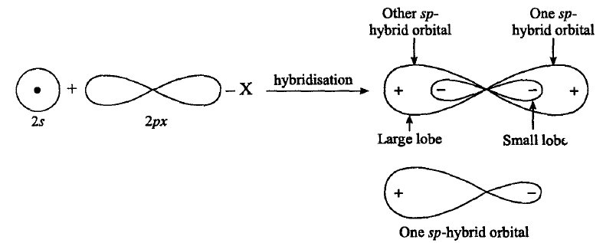
sp or Digonal Hybridisation :
In this type of hybridisation one s and one p-orbital of the valence shell of central atom of the given molecule combine to form two sp hybrid orbitals as follows:

Slide 11
Characteristic of sp-Hybrid Orbitals
Both sp-hybrid orbitals are completely equivalent and symmetrical.
Energy of sp-hybrid orbital is more than s-orbital but less than the p-orbital.
These two sp-hybrid orbitals are collinear, i.e., angle between the hybrid orbitals is 180°.
Shape of sp-hybrid orbital is oval.
Its relative power of overlapping is 1.93 with respect to s orbital.
In sp-hybrid orbital one lobe is bigger while other lobe is small. The bigger lobe is very large with respect to p-orbital, hence it has higher degree of overlapping. Thus it forms stronger bond.

Slide 12
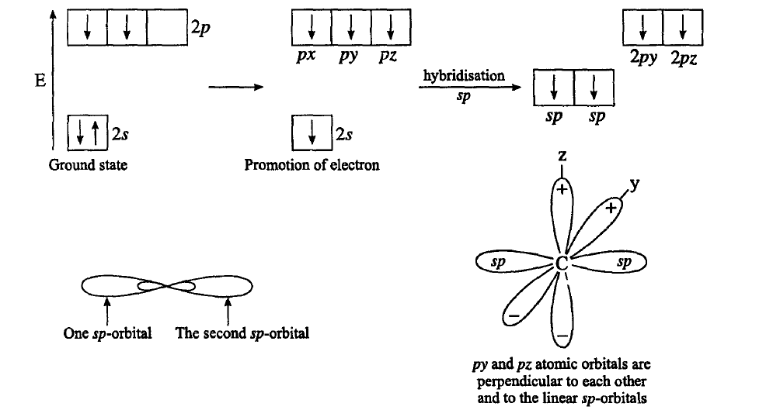
Example: Acetylene (C₂H₂)

Slide 13
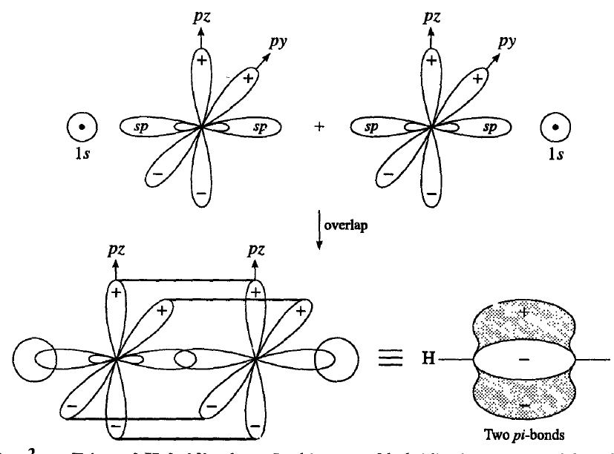

Slide 14
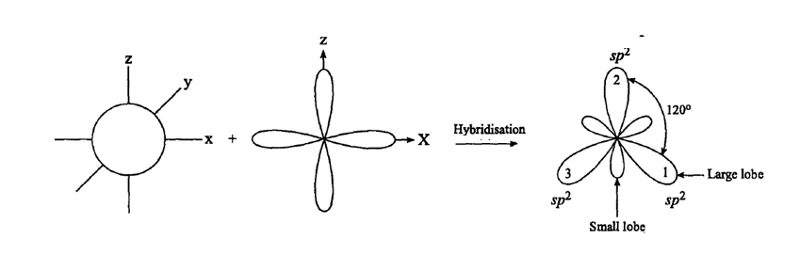
sp² or Trigonal Hybridisation :
In this type of hybridisation one s and 2p orbitals of the valence shell of central atom of the given molecule combine to form three sp²-hybrid orbitals as shown below:

Slide 15
Characteristics of sp² Hybridisation :
(1) These sp²-hybrid orbitals are completely equivalent and symmetrical.
(2) These hybrid orbitals are planar with bond angle 120°.
(3) Since in this hybridisation contribution of p-orbitals is more hence it is less oval than sp-hybrid orbitals. In this case one lobe is bigger and one lobe is smaller and it forms stronger bond.
(4) These are stronger than s and p orbitals. Its relative power of overlapping is 1.99 with respect to s-orbital

Slide 16
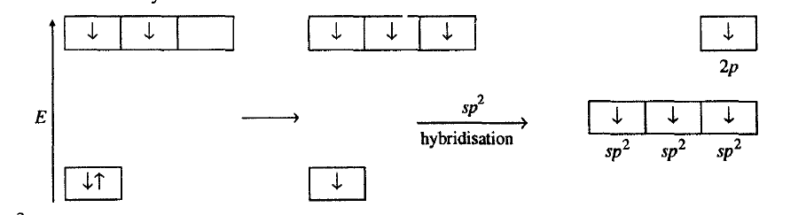
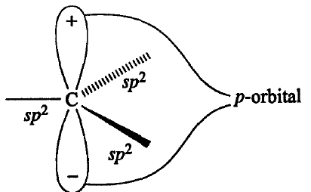
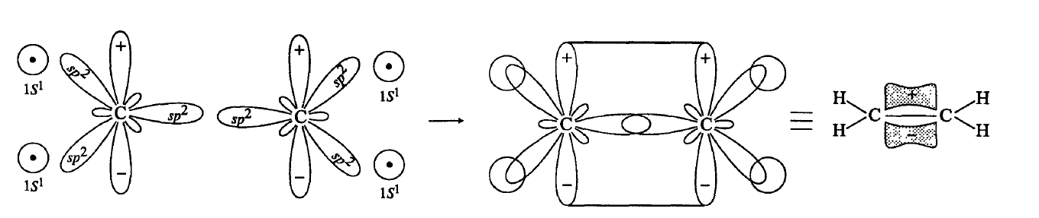
Example: Ethylene (C₂H₄)

Slide 17
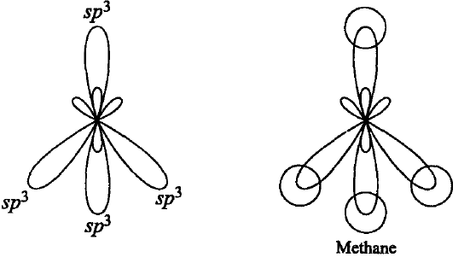
sp³ or Tetrahedral Hybridisation:
In this hybridisation one s and three p-orbitals of the valence shell of central atom of the given molecule combine to form four sp³-hybrid orbitals.

Slide 18
Characteristics of sp³ Hybridisation :
(1) All the four sp³ hybrid orbitals are completely equivalent and symmetrical.
(2) These orbitals are directed towards the four comers of a regular tetrahedron and the angle between each pair of them is 109° 28' or 109.5°.
(3) Their relative power of overlapping is 2.00 with respect to s-orbital. This shows that sp³ -orbitals are stronger than sp which is stronger than sp-orbitals.
(4) Since in sp³-hybridisation the contribution of p-orbitals is 75%, its shape is almost same as that of the parent p-orbitals except that the bigger lobe in sp³ -orbital is somewhat more spread and shorter in length than the pure p-orbitals

Slide 19
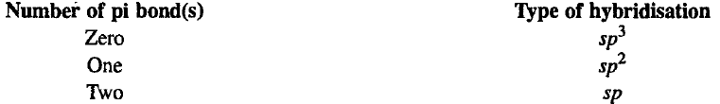
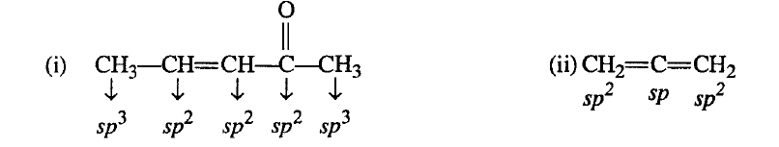
Hybridisation in Organic Species
Hybridisation in organic species can be known by two methods:
First Method:
In this method hybridisation can be known by the number of pi bonds present on that particular atom.
Example
This method cannot be used for those atoms of the molecule which have positive charge, negative charge or odd electron

Slide 20
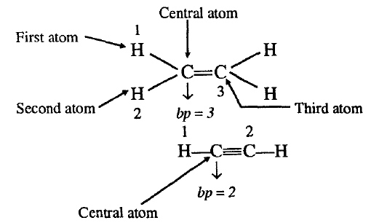
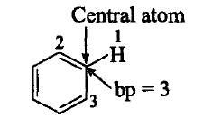
Second method:
Electron pair method
ep = bp + lp
where
ep = electrons pair present in hybrid orbitals
bp = bond pair present in hybrid orbitals
lp = loan pair present in hybrid molecule
Determination of bond pairs :
Number of bp = Number of atoms present on central atom of the species

Slide 21
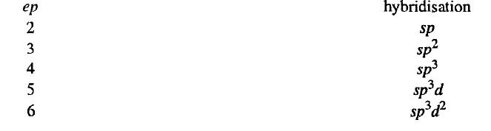
Determination of lone pair of electrons:
Number of Ip's can be determined as follows:
(i) If carbon has pi bond/(s) or positive charge or odd electron, then lp on carbon will be zero.
(ii) If carbon has negative charge, then Ip will be equal to one.
Number of electron pairs tells us the type of hybridisation as follows:

Slide 22
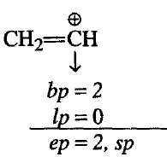
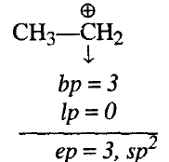
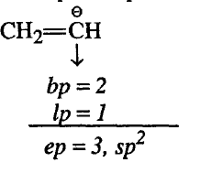
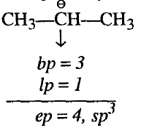
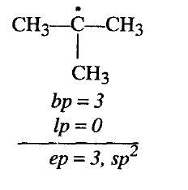
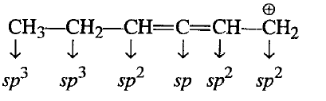

Slide 23
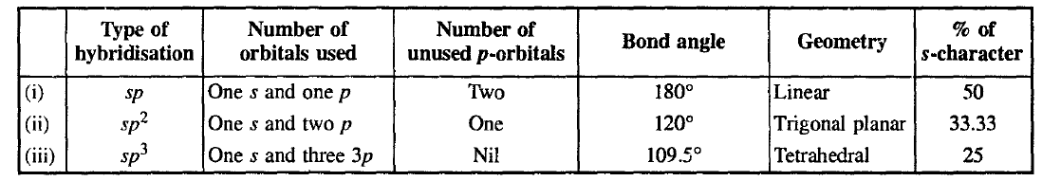
Hybridisation and Bond Properties
Bond properties like bond angles, geometry of molecules, electronegativity, dipole moments, bond lengths, bond strengths, bond energies and acidity of hydrocarbons are greatly influenced by the hybrid' states of bonded atoms
1. Bond Angles and Geometry of the Molecule:
The carbon valency angles follow the following order:
sp³ (109.5 º) < sp² (120 º) < sp (180 º)

Slide 24

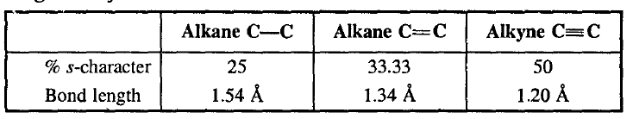

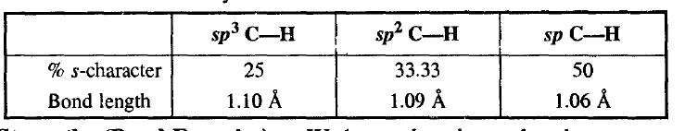
2. Bond Lengths:
An s-orbital is nearer to the nucleus than a p-orbital of the same shell. Hence, a hybrid orbital with more s-character is also nearer to the nucleus and it has smaller size than a hybrid orbital with more p-character.
The sizes of different hybrid orbitals follow the following order:
sp³ > sp² > sp

Slide 25

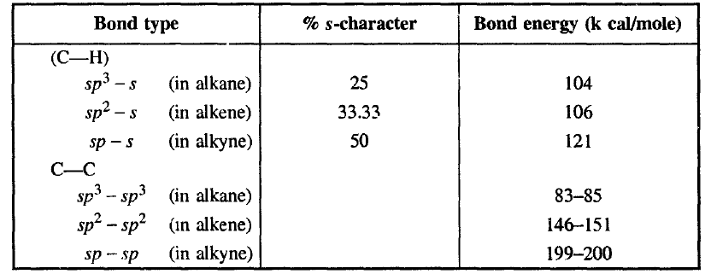
3. Bond Strengths (Bond Energies):
Since shorter bonds are stronger bonds. Thus, bond energies (and bond strengths) of bonds in different hybrid states follow the following order:
sp³ < sp² < sp

Slide 26

4. Electronegativity:
The power of an atom to attract electrons of a bond is called electronegativity.
Since overlapping of orbitals with more s-character have a shorter bond length, consequently their electrons are nearer to the nucleus and will be attracted towards the nucleus with a greater force. This means, the greater is the s-character in a hybrid orbital, the greater will be the electronegativity of the atom in that hybrid state.
The order of electronegativities of carbon in different hybrid states is :
sp³ < sp² < sp

Slide 27

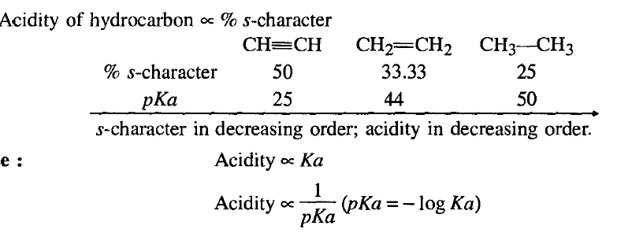
5. Acidity of Hydrocarbons:
Hydrogen present on electronegative carbon is acidic in character.
Acidity of hydrogen is directly proportional to the electronegativity of atom on which hydrogen is present.

Slide 28
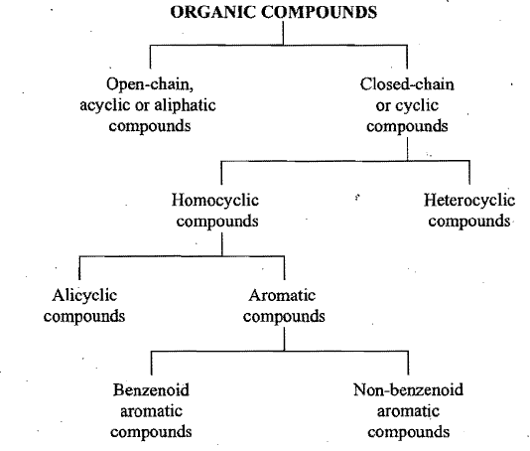
CLASSIFICATION OF ORGANIC COMPOUNDS
Based on Structure
Based on Functional Group
Based on Structure

Slide 29
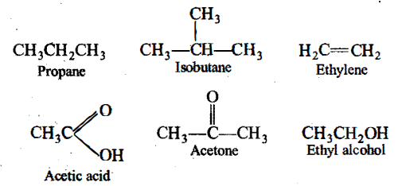
Acyclic or Open-chain compounds :
These are the compounds in which the carbon atoms are linked to each other in such a manner that the molecule is having an open-chain structure.
The chain of the carbon atoms may be straight or branched. These compounds are also called as aliphatic compounds.

Slide 30
Cyclic or Closed-chain compounds :
These are the compounds in which carbon atoms are linked to each other or to the atoms of other elements in such a manner that the molecule has a closed-chain or cyclic or ring structure.
The compounds with only one ring of atoms in the molecule are known as monocyclic but those with more than one ring of atoms are termed as polycyclic.
These are further divided into two subgroups:
Homocyclic or Carbocyclic,
Heterocyclic.

Slide 31
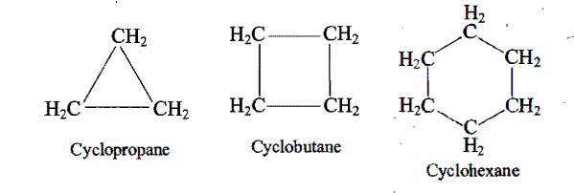
Homocyclic or Carbocyclic : These are the compounds having a ring or rings of carbon atoms only in the molecule.
The carbocyclic or homocyclic compounds may again be divided into two types:
(i) Alicyclic compounds and
(ii) Aromatic compounds.
Alicyclic compounds : These are the compounds which contain rings of three or more carbon atoms.
These resemble with aliphatic compounds than aromatic compounds in many respects. That is why these are named alicyclic, i.e., aliphatic cyclic. These are also termed as polymethylenes.

Slide 32
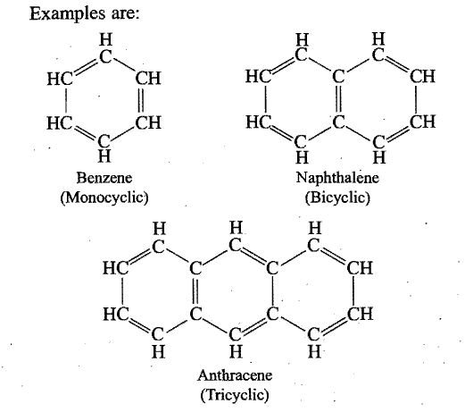
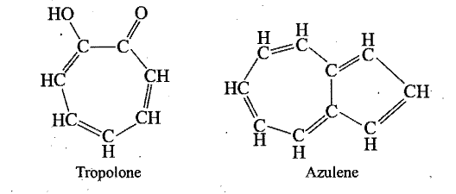
(ii) Aromatic compounds :
These· compounds consist of at least one benzene ring, i.e., a six-membered carbocyclic ring having alternate single and double bonds. Generally, these compounds have some fragrant odour and hence, named as aromatic (Greek word aroma meaning sweet smell) .
These compounds are also known as benzenoid aromatics as their molecules consist of benzene ring or rings.
However, there are aromatic compounds, which have structural units different from benzenoid type, and are known as non-benzenoid aromatics.

Slide 33
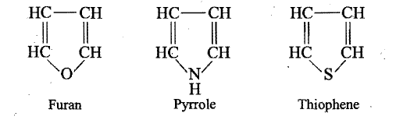
(b) Heterocyclic compounds:
These are cyclic compounds having ring or rings built up of more than one kind of atoms.
The most common other atoms (hetero-atoms) besides carbon are 0, N and S.

Slide 34

Classification Based on Functional Groups
The compounds of only carbon and hydrogen are called hydrocarbons.
Hydrocarbons are considered as the parents of all the organic compounds.
All other compounds are obtained from hydrocarbons by the replacement of one or more hydrogen atoms with other atoms or groups.
most of the organic compounds consist of two parts, each of which is called a group or radical.
R = represents the carbon-hydrogen framework
affects the physical properties
X = functional group
responsible for the chemical properties of the compound

Slide 35
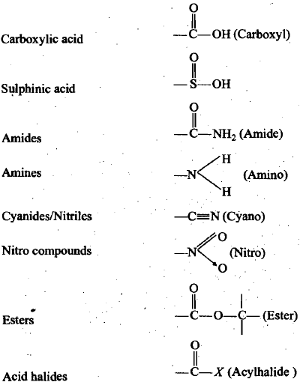
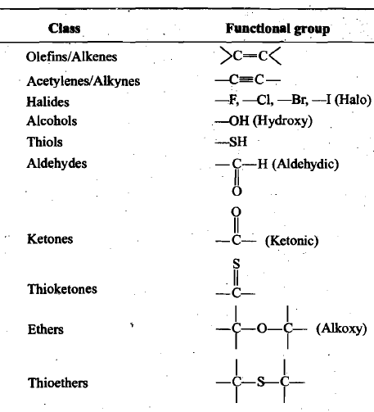
Certain compounds contain more than one functional groups. Such compounds are called polyfunctional compounds.
The properties of each functional group may be modified by the presence of the others.

Slide 36
Homologous series:
A homologous series can be defined as a group of compounds in which the various members have similar structural features and similar chemical properties and the successive members differ in their molecular formula by CH₂.

Slide 37
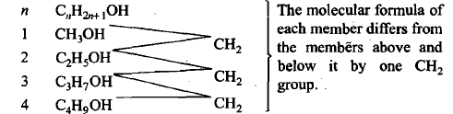
Properties of Homologous series
All compounds in the series are composed of same elements and contain the same functional group.
All compounds in the series can be represented by one general formula,
The molecular mass of every two adjacent members differs by 14
All compounds in the series have similar chemical properties because of the presence of same functional group.
The members of the series show a gradual gradation in their physical properties like solubility, density, melting and boiling points. The physical properties generally increase as the molecular mass increases.
The homologues can be prepared by almost similar methods. These are known as general methods of preparation

Slide 38
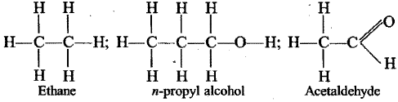
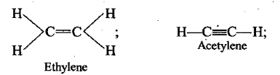
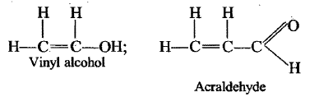
SATURATED AND UNSATURATED COMPOUNDS
If, in an organic compound containing two or more carbon atoms, there are only single bonds between carbon atoms, then the compound is said to be saturated, e.g., ethane, n-propyl alcohol, acetaldehyde, etc
If the compound contains at least one pair of adjacent carbon atoms linked by a multiple bond, then that compound is said to be unsaturated, e.g., ethylene, acetylene, vinyl alcohol, acraldehyde, etc.·

